Slide 1

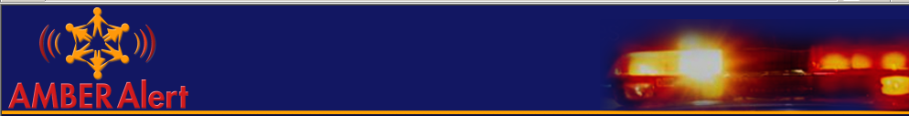


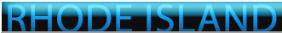

Rhode Island State Police
Awareness
AMBER ALERT
Colonel Ann C. Assumpico
Superintendent, Rhode Island State Police
Director, Rhode Island Department of Public Safety

Slide 2

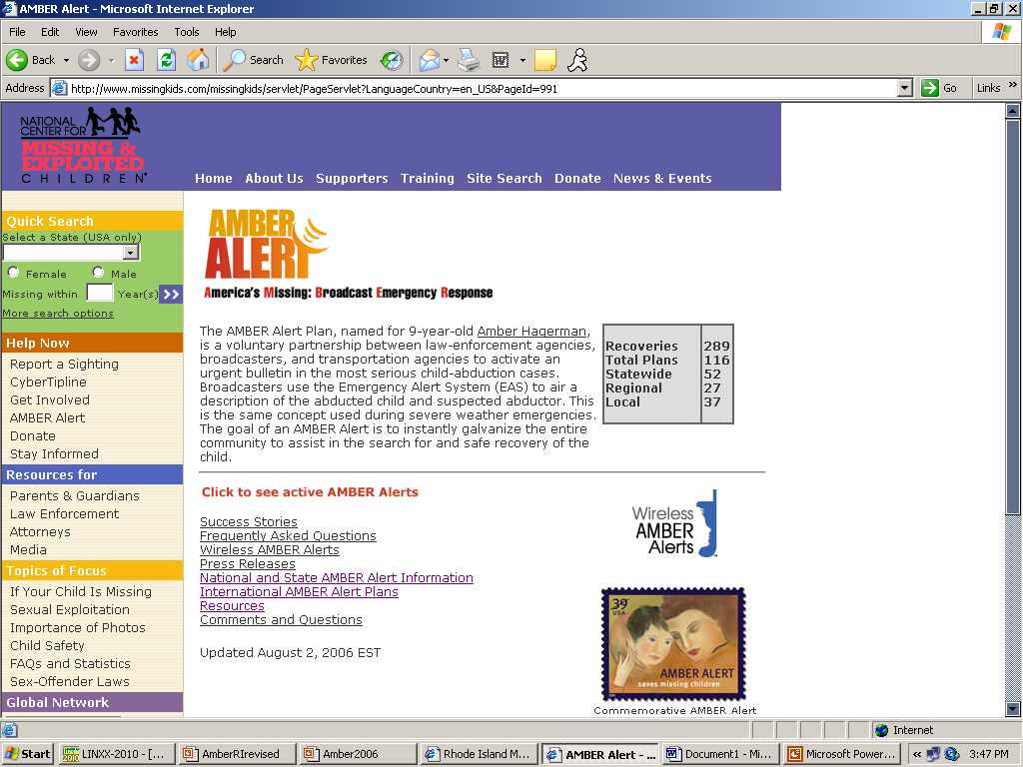

AMBER Alert Awareness Day
On January 13, communities across the country will observe
National AMBER Alert Awareness Day – a day to recognize
the collaborative efforts and successes of the AMBER Alert
program to assist in the recovery of abducted children.
AMBER Alert

Slide 3
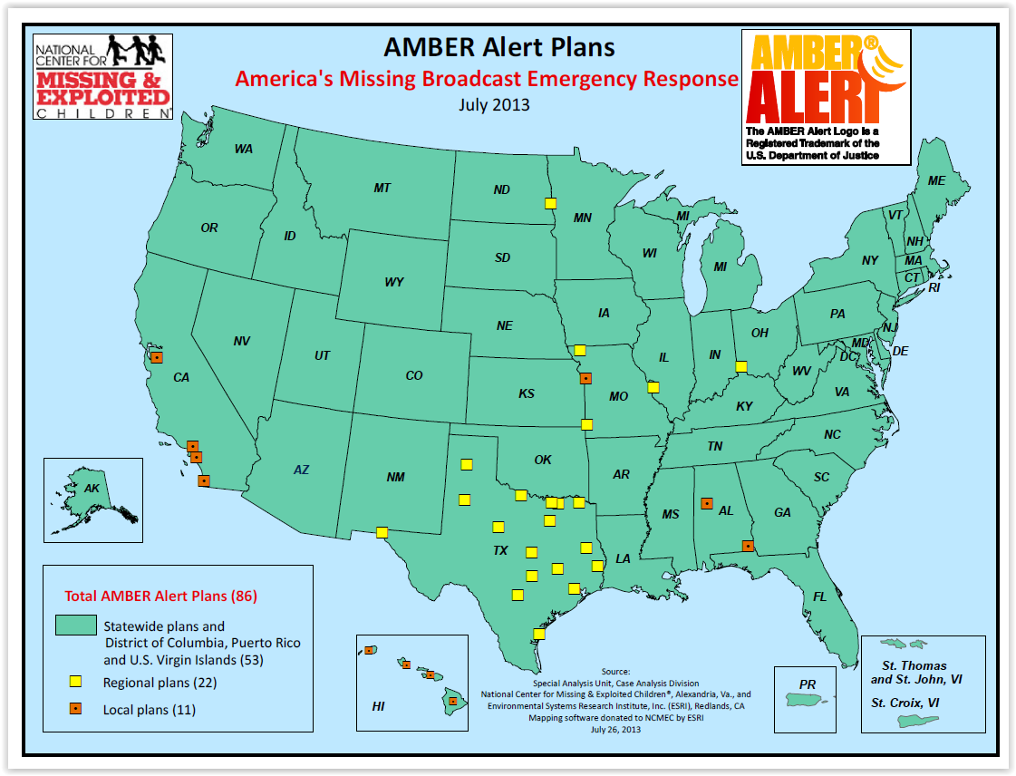

AMBER PLAN SUCCESS
NCMEC reports that there are 86 AMBER Plans on the local, regional and statewide levels
(53 Statewide, 22 Regional, and 11 Local)
Visit: www.missingkids.com for current data on plans and successes.
AMBER Plan Statistics:
Successful Recoveries….924
Total Plans Nationwide…86
Statewide...53
Regional…….22
Local………...11
March 2018

Slide 4











































Rhode Island Law Enforcement
Working Together for a Safer Tomorrow

Slide 5

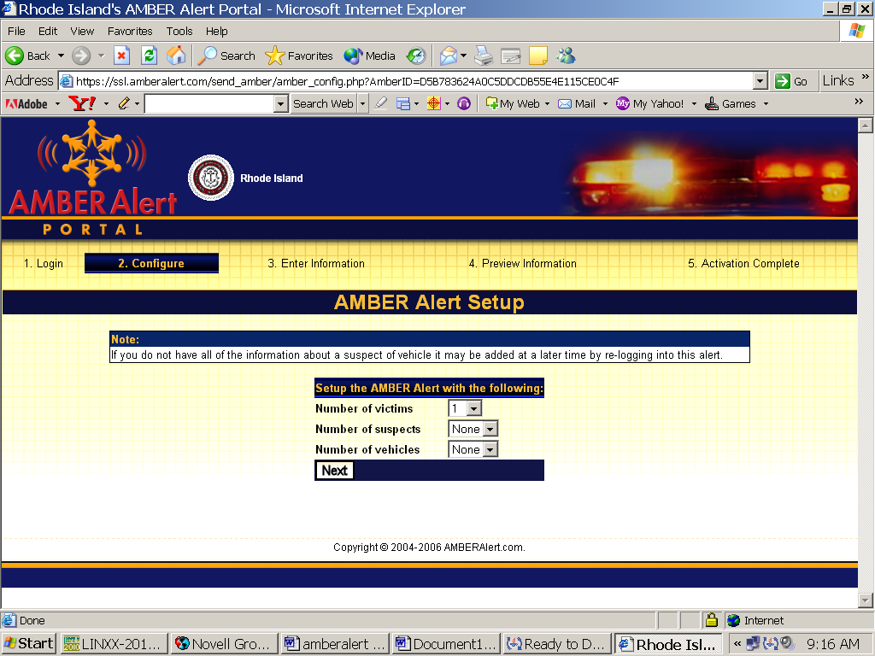

Coordinating Law Enforcement Agency
Rhode Island State Police
Coordinating Council
RI Office of Lieutenant Governor
RI Department of Attorney General
RI Emergency Management Agency
RI Broadcasters Association
RI Police Chief’s Association
RI State Police
RI DOT
E-911
RI.Gov

Slide 6

When and why was the AMBER plan created?
The AMBER Plan was created in 1996 as a powerful legacy to 9-year-old Amber Hagerman, a bright little girl who was kidnapped and brutally murdered while riding her bicycle in Arlington, Texas.
The tragedy shocked and outraged the entire community. Residents contacted radio stations in the Dallas area and suggested they broadcast special “alerts” over the airwaves so that they could help prevent such incidents in the future.
In response to the community’s concern for the safety of local children, the Dallas/Fort Worth Association of Radio Managers teamed up with local law-enforcement agencies in northern Texas and developed this innovative early warning system to help find abducted children. Statistics show that, when abducted, a child’s greatest enemy is time.

Slide 7

AMBER Alert
^{A}merica's ^{M}issing: ^{B}roadcast ^{E}mergency ^{R}esponse
The AMBER plan is a voluntary, cooperative partnership between law-enforcement agencies and broadcasters to send an emergency alert to the public when a child has been abducted and it is believed that the child's life is in grave danger.
Under the AMBER Alert plan, area radio and television stations interrupt programming to broadcast information about the missing child and the suspected abductor using the Emergency Alert System, formerly known as the Emergency Broadcast System.
The Federal government requires that all radio and television stations and most cable systems install and maintain devices that can monitor EAS warnings and rapidly and reliably relay this information to the public when necessary.

Slide 8









Photos are not of actual missing children
http://www.missingkids.com
As stated by the National Center for Missing and Exploited Children:
“It’s important to understand the AMBER Alert must be used appropriately and not overused. If the early warnings are not accurate and/or case doesn’t warrant an alert, then the integrity and credibility of the plan will be diminished if the plan is activated in those situations.”

Slide 9

Benefits
It's a powerful law enforcement tool and wonderful way broadcasters can contribute to their communities by
issuing the alerts. It sends a strong message that these agencies are providing a proactive way to help protect
the community’s children.
Experience has shown that extensive radio and television coverage can dramatically increase law
enforcement’s ability to locate witnesses and help resolve these cases more quickly.
It helps build relations between law enforcement, broadcaster’s, and the community.
It provides each agency with a quick response to serious child abductions, along with the means to
rapidly disseminate the information.
Once the alert goes out, it engages entire communities to mobilize and assist with recovering the
child and apprehending the abductor.
The AMBER Plan not only recovers abducted children, but acts as a deterrent to this type of crime.

Slide 10

AMBER Alert Process
Police Receive
Complaint
NO, Utilize
Other Resources
Preliminary Review by
Investigating Agency.
Does Abduction Fit
AMBER Alert Criteria
NO
YES
Coordinator
Determines Warranted.
Plan Initiated.
RISP Contacted,
Request for Alert
Reviewed
AMBER Alert
Not Activated
YES
NO
AMBER Alert
Activated

Slide 11


Preliminary Review by
Investigating Agency
AMBER Alert
Does Abduction fit AMBER Alert criteria?
Is this believed to be a ‘child’ abduction?
  A ‘child’ is a person seventeen (17) years of age or younger.
Is there enough descriptive information about the child, the
abductor, or suspect’s vehicle to believe an immediate broadcast alert
will assist in the safe recovery of victim or apprehension of a suspect?
Are the circumstances surrounding the abduction indicating
the child is facing imminent danger, bodily harm or death

Slide 12

AMBER Alert
CIRCUMSTANCES
When an Alert May Be Activated:
Child is abducted and there are witnesses to the crime.
Child is missing but there is evidence of foul play, and law enforcement believes the child abducted.
Vehicle was stolen or “car-jacked” and a child was left inside the vehicle.
Child is missing and particular consideration is given to their behavior or mental capacity in some way contributing to their disappearance. The child is also considered endangered.
Runaway or parental abduction cases – only – if there is specific reason to believe the life of the child is in imminent danger. The Emergency Alert Plan is not normally used for runaway or parental abduction cases.

Slide 13




AMBER Alert
Activated
“This is a child abduction alert, please stand by for important information”
EAS – message will be broadcast by Coordinator to radio, television, cable stations. Broadcast will include “This is a child abduction alert, please stand by for important information”.
Instructions for public to call 46-AMBER / 462-6237 or 911 with any information. A description of the abducted child and the suspected abductor is broadcast to millions of media listeners and viewers. The public becomes the eyes and ears of law enforcement.
AMBER Alert – activated via AMBER Alert web portal
911 – forwards all calls regarding alert to RI EMA
RI EMA – Opened, team responds
RI DOT – TMC – will program message signs for display along
Rhode Island highways (and in MA & CT – highways bordering RI).

Slide 14

AMBER Alert Will
-NOT- Be
Activated
AMBER Alert
IF
A child is missing and law enforcement has no evidence of foul play.
A child runs away from home.
A child is missing as a result of a custody dispute and the child is
not considered to be at risk of bodily harm or death
An adult is missing.
Authorities are looking for wanted criminals who are bank robbers
or alleged murder suspects in adult crimes.

Slide 15

NO AMBER Alert,
Other Resources Available
Some Additional Resources–
National Center for Missing & Exploited Children: http://www.missingkids.com
AMBER Alert Portal – http://www.amberalert.com
U.S. Department of Justice – AMBER Alert: http://www.amberalert.gov
NetSmartz - http://www.netsmartz.org/
NetSmartz411 = http://www.netsmartz411.org/
Polly Klaas Foundation: http://www.pollyklaas.org/

Slide 16
National Missing Children's Day
In 1983 President Ronald Regan proclaimed May 25 National Missing Children’s Day.
Each administration since has honored this annual reminder to the nation to renew efforts to reunite missing children with their families and make child protection a national priority. National Missing Children’s Day is a reminder to all parents and guardians of the need for high-quality photographs of their children for use in case of an emergency, and for the need for everyone to pay close attention to the posters and photographs of missing children.
Read more about National Missing Children’s Day being established:
http://www.missingkids.com/missingkids/servlet/NewsEventServlet?LanguageCountry=en_US&PageId=1305

Slide 17

BEFORE Sharing an Alert
Before you share an Alert on social media, please confirm the alert is still active and can do so by visiting the National Center for Missing & Exploited Children (NCMEC) site:
http://www.missingkids.org/Amber.html

Slide 18
Other sites for
AMBER Alert information
Sign up to receive alerts: http://esp.missingkids.org/gethelpnow/amber/ambersignup
Facebook page for AMBER Alerts: https://www.facebook.com/AMBERalert
To learn more about AMBER Alert guidelines visit: https://amberalert.gov/guidelines.htm

Slide 19

Thank you for your interest in helping to keep our children safe!
Joan Marie Collins
Police Communications Specialist Supervisor
Alert Program Administrator
Rhode Island State Police
RI AMBER Alert Awareness
Microsoft PowerPoint Presentation
September 2012, update May 2014
Update Dec 2016, update Aug 2018
JMC
Please note: Changes can not be made to this AMBER Alert presentation without authorization from the Rhode Island State Police

